Slide 1

Simulation-based inference
BAMB! 2025 Summer School Tutorial 6C – Alex Hyafil

Slide 2

Computing the likelihood
Difficult because we need to marginalize over latent variables z
direct access:
psychometric curve (with/without lapses) [Wichmann&Hill, 2001]
generalized linear model
standard DDM
RL model with deterministic value update
numerical approximation/integration:
generalized DDM [Shinn et al, eLife 2001]
expectation-maximization: for latent variable model
HMM, Gaussian mixtures
RL model with stochastic value update, Kalman filter
GLMM
SO WHAT IN OTHER CASES??

Slide 3
Naive approach: manual fitting
Adjusting the parameters so that it qualitatively matches the metrics of behavior we want to reproduce (we are basically doing model validation directly)
But not very principled…
This can be done qualitatively using a family of methods known as Approximate Bayesian Computation (ABC), which are very nice in practice but also very impractical
Now a new family for using simulations to fit behavior using neural networks to approximate the likelihood.

Slide 4
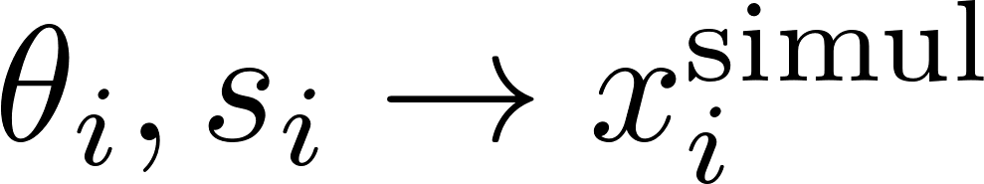
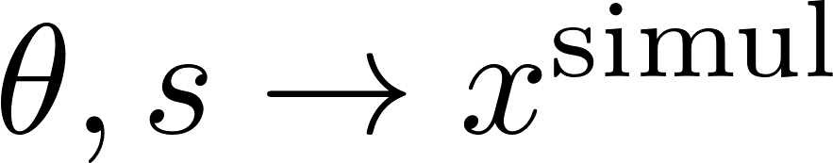
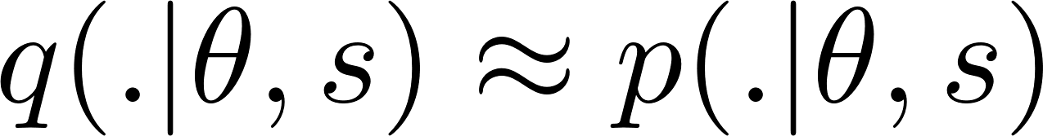
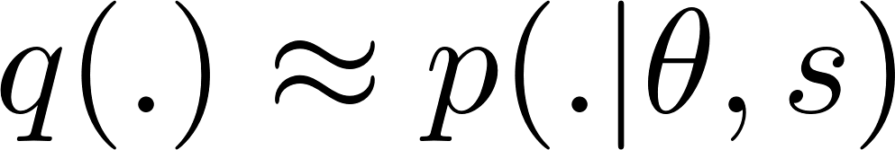
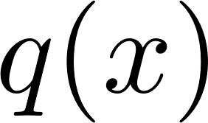
Amortized vs. non amortized inference
Non-amortized inference
During maximum-likelihood estimation, for every set of parameters θ we test:
simulate the model with these parameters
Use these simulations to train a neural network to approximate likelihood
Use pseudo-likelihood on experimental dataset
Amortized inference
simulate the model with varying parameters and conditions
Use these simulations to train a neural network that approximates likelihood conditioned on parameter
Perform MLE (or Bayesian fitting) on experimental dataset using pseudo-likelihood

Slide 5
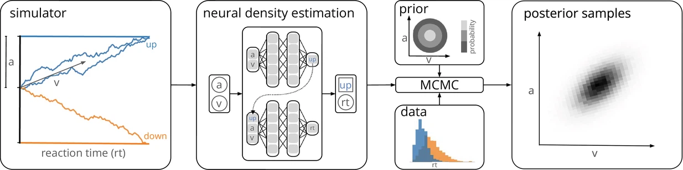
Mixed Neural Likelihood Estimation (MNLE) for accumulation-to-bound models
can include more than one categorical or continuous variable (e.g. choice, reaction time and movement time in Molano-Mazón et al., NatComms (2024)
Boelts et al., eLife (2022)

Slide 6
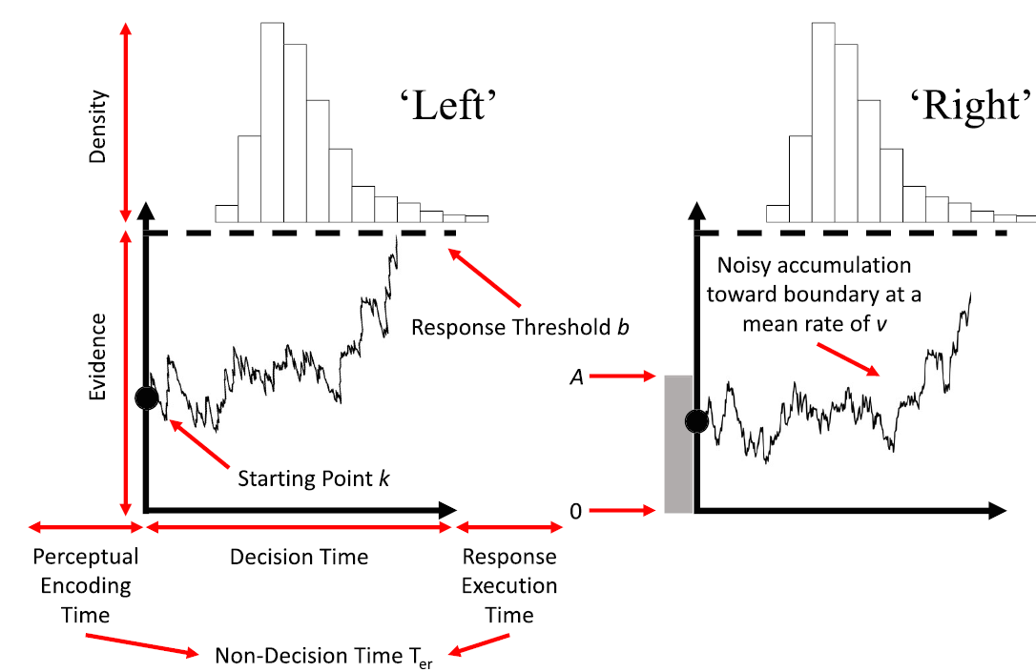
Race models
Tillman et al. PBR (2020)

Slide 7
Limitations of simulation-based inference
Still quite novel and not yet as ‘plug-and-play’ as other techniques (but I hope this tutorial helps)
Neural networks can learn in theory a function of any input space, but in practice the number of parameters + experimental conditions is limited (say below 15-20) by size of training set (10 millions trials?)
This can be sometimes addressed by incorporating knowledge about the likelihood outside the neural approximator (i.e. in DDM non-decision time just shifts RT, so no need to include it as input to NN)
(akik) No method for dealing with sequential data (with stochastic latents)

